Slide 1
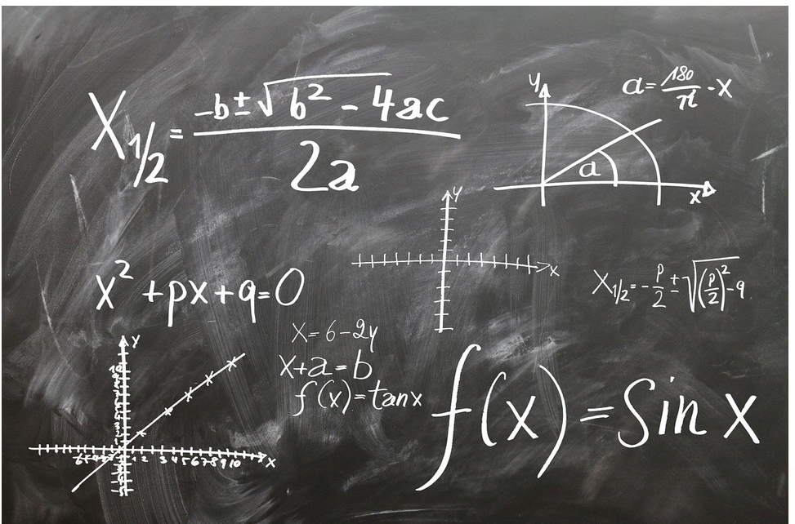

Slide 2
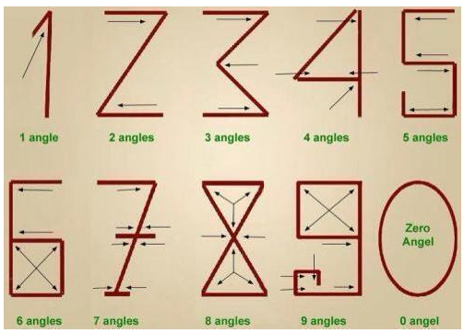

Slide 3
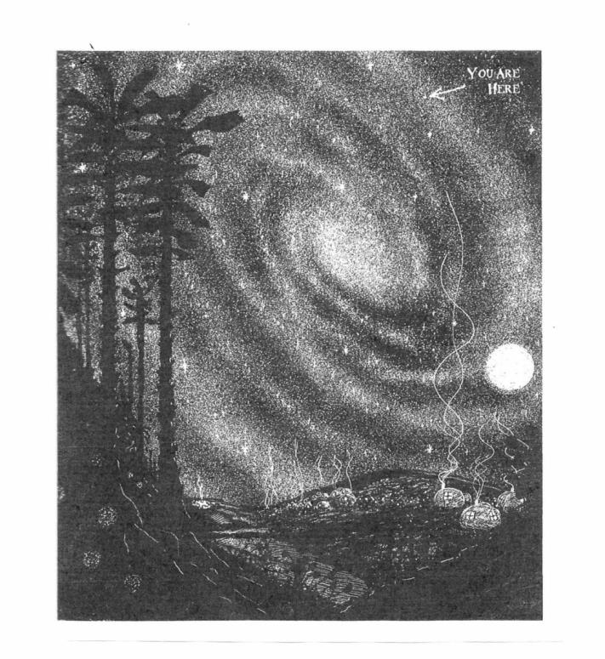

Slide 4
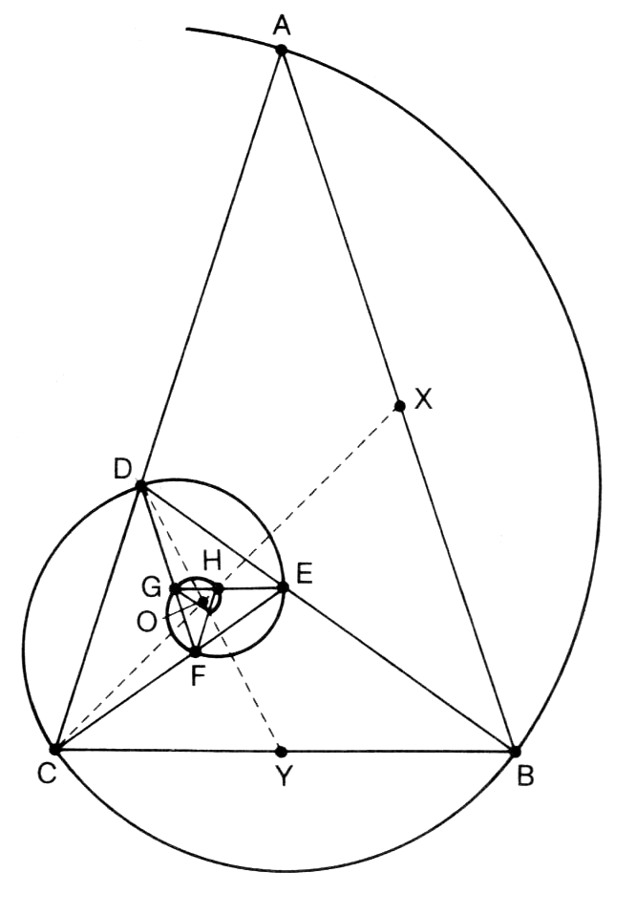
Spira Mirabilis

Slide 5
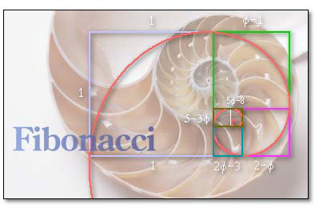

Slide 6
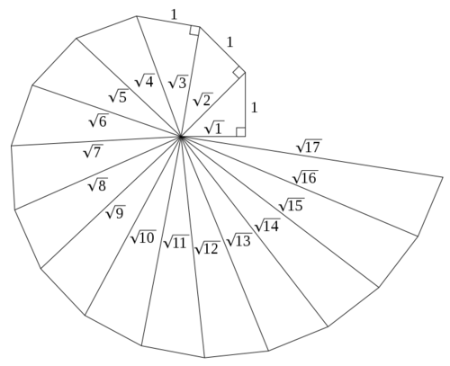

Slide 7
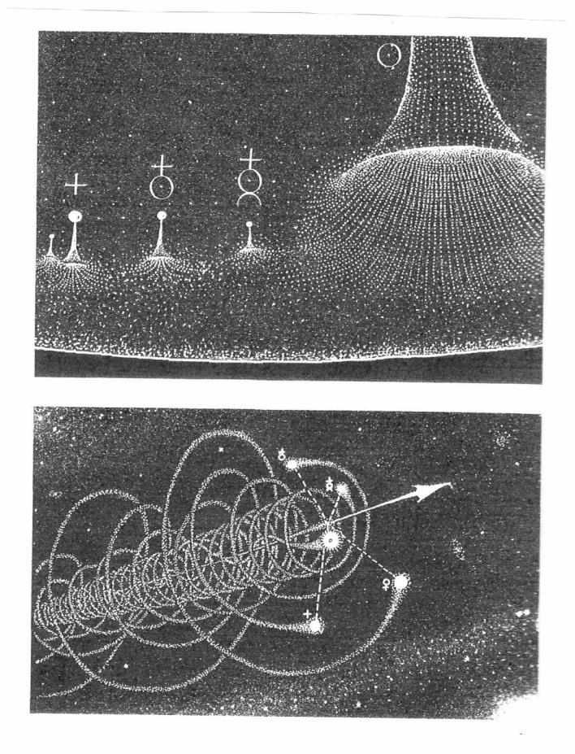
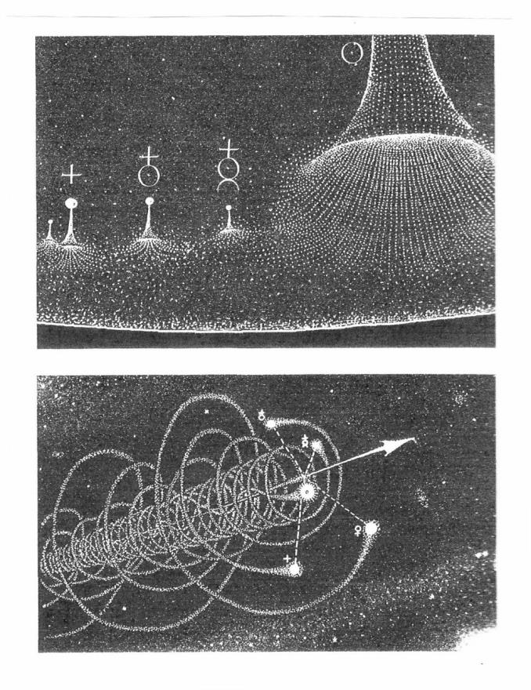

Slide 8
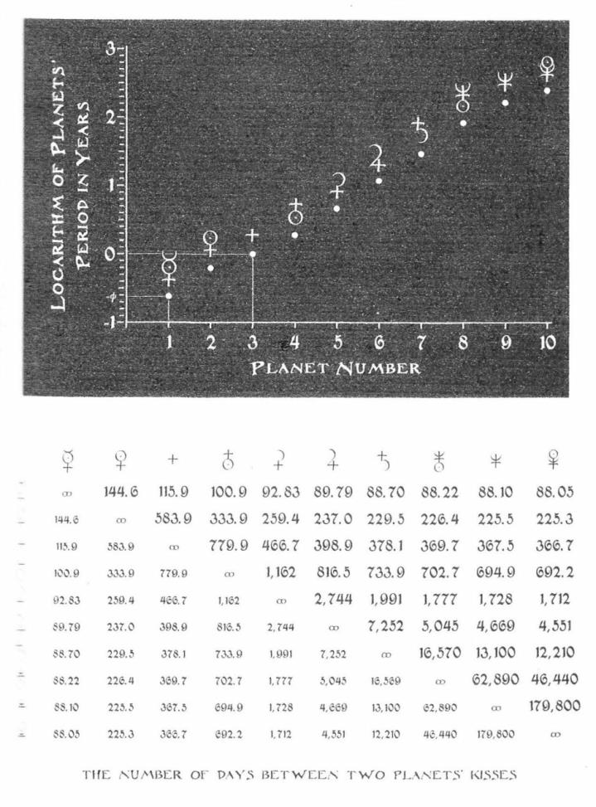

Slide 9
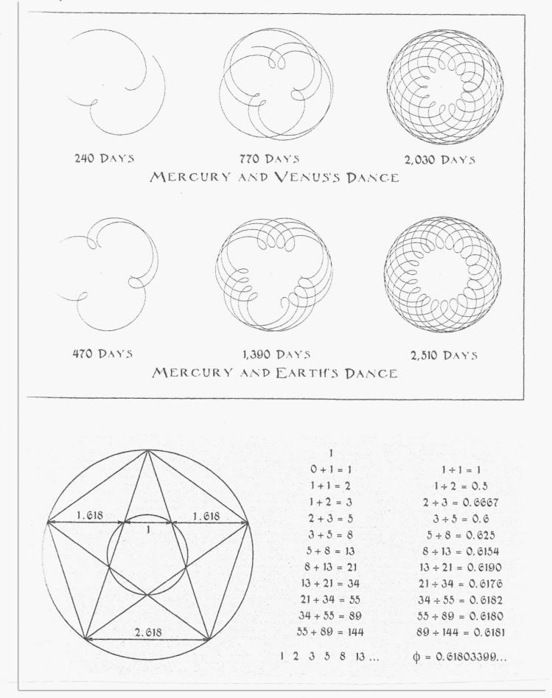

Slide 10
This Alchemy May Yield Real Gold
Technical Analysts, The Street's Soothsayers Get A Vote Of Confidence From MIT Rocket Scientists
Technical analysts don't get no respect. Academic economists consider their game--predicting stock prices by studying charts--on a par with examining the entrails of a freshly slaughtered goat. Conventional economic wisdom says that stock prices already reflect all relevant information, so past movements are no clue to future ones. Even if stock prices are a little predictable, say most economists, you won't get anywhere by poring over charts for such technical-analyst arcana as "rising bottoms," "double tops," and "head-and-shoulders formations." Burton G. Malkiel, author of A Random Walk Down Wall Street, writes that "under scientific scrutiny, chart reading must share a pedestal with alchemy."
But technical analysts--also known as chartists--may yet get the last laugh. A paper written by three authors from the Massachusetts Institute of Technology, and recently published by the prestigious National Bureau of Economic Research, concludes that "certain technical patterns do provide incremental information, especially for Nasdaq stocks." In language that's bold for academics, the paper goes on to say that "while this does not necessarily imply that technical analysis can be used to generate `excess' trading profits, it does raise the possibility that technical analysis can add value to the investment process."
Technical analysis might actually add value? Predictably, technical analysts are overjoyed by the partial endorsement. "I'm, like, flabbergasted," says Ralph J. Acampora, the director of technical research at Prudential Securities Inc. The chartists are particularly pleased that the project was led by Andrew W. Lo, director of MIT's Laboratory for Financial Engineering, who taught many of the finance rocket scientists now working on Wall Street. Says Acampora: "This gives the field an awful lot of credibility."
The paper, by Lo, graduate student Harry Mamaysky, and finance professor Jiang Wang (http://www.nber.org/papers/w7613), is tough slogging unless you happen to be on intimate terms with kernel regression estimators and the Kolmogorov-Smirnov test. But its basic strategy is simple. First, the authors wrote a computer program that automated the process of finding 10 of the chartists' favorite patterns. Then they turned the program loose on daily stock returns for hundreds of companies on the New York Stock Exchange, American Stock Exchange, and Nasdaq from 1962 to 1996. Out of more than 800,000 observations of raw data, the program turned up about 2,500 head-and-shoulders patterns (three peaks, the middle one being the highest), about 2,100 triangle tops (a pattern with progressively lower peaks and rising bottoms), and so on.

Slide 11
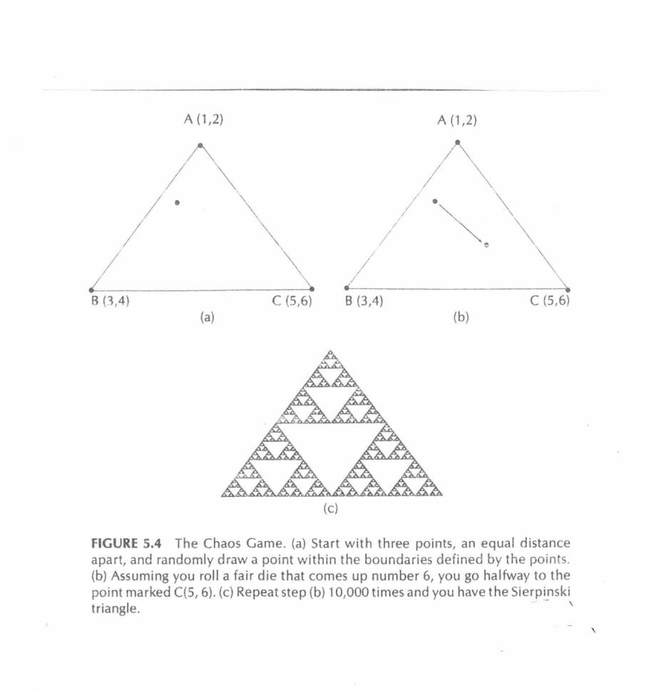

Slide 12
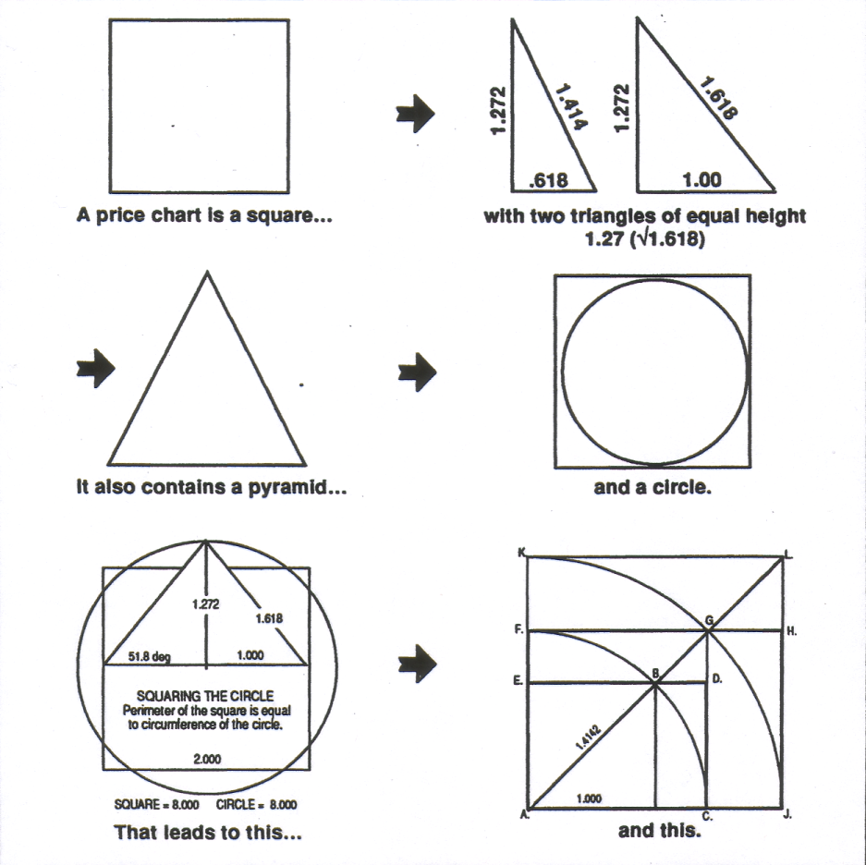
Geometric Characteristics of a Price Chart
Technicians use price charts to interpret what the next move is most likely to be.
Let us consider the following:

Slide 13
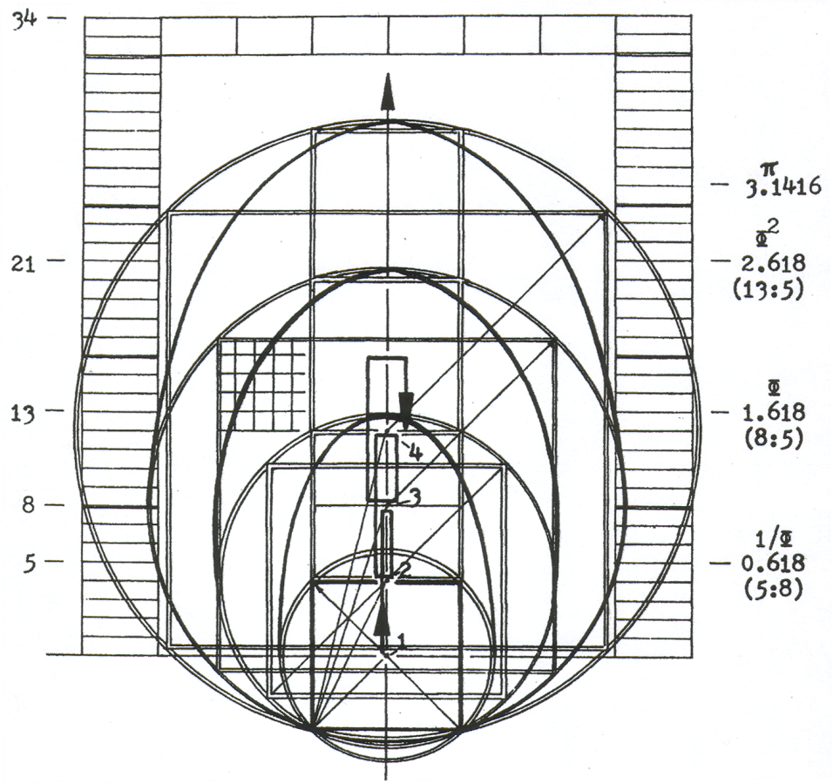
The Forces and Framework of the Cyclical Structure
How a Cycle Grows From a Series of Thrusts and Recoils

Slide 14
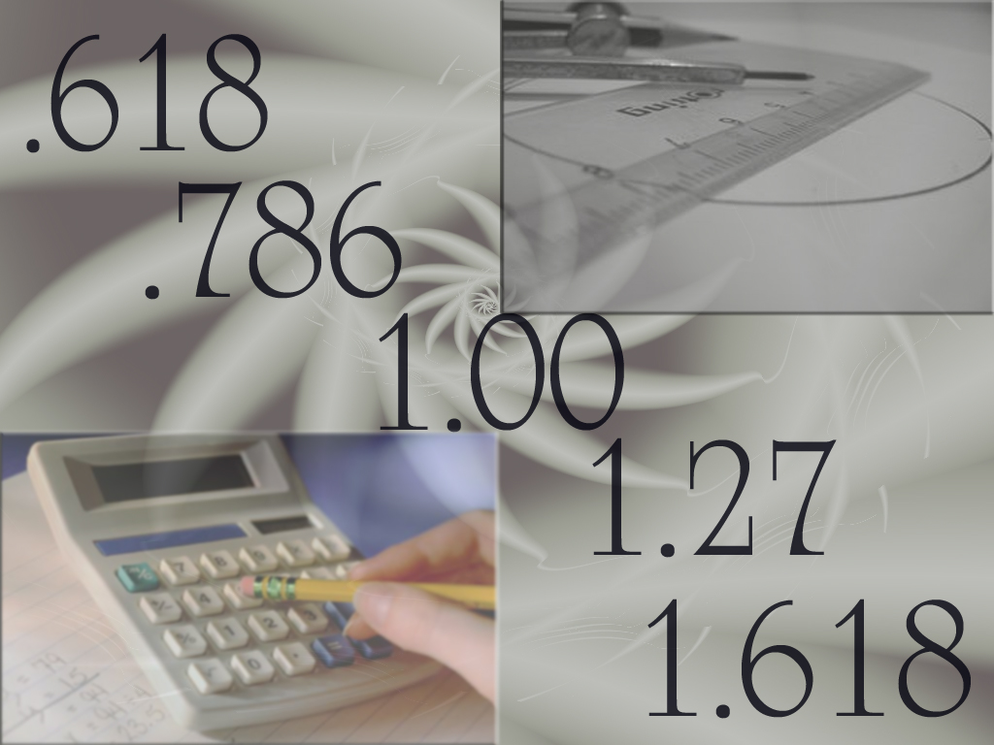
Learning these patterns and ratios requires only a calculator, ruler and pencil.

Slide 15
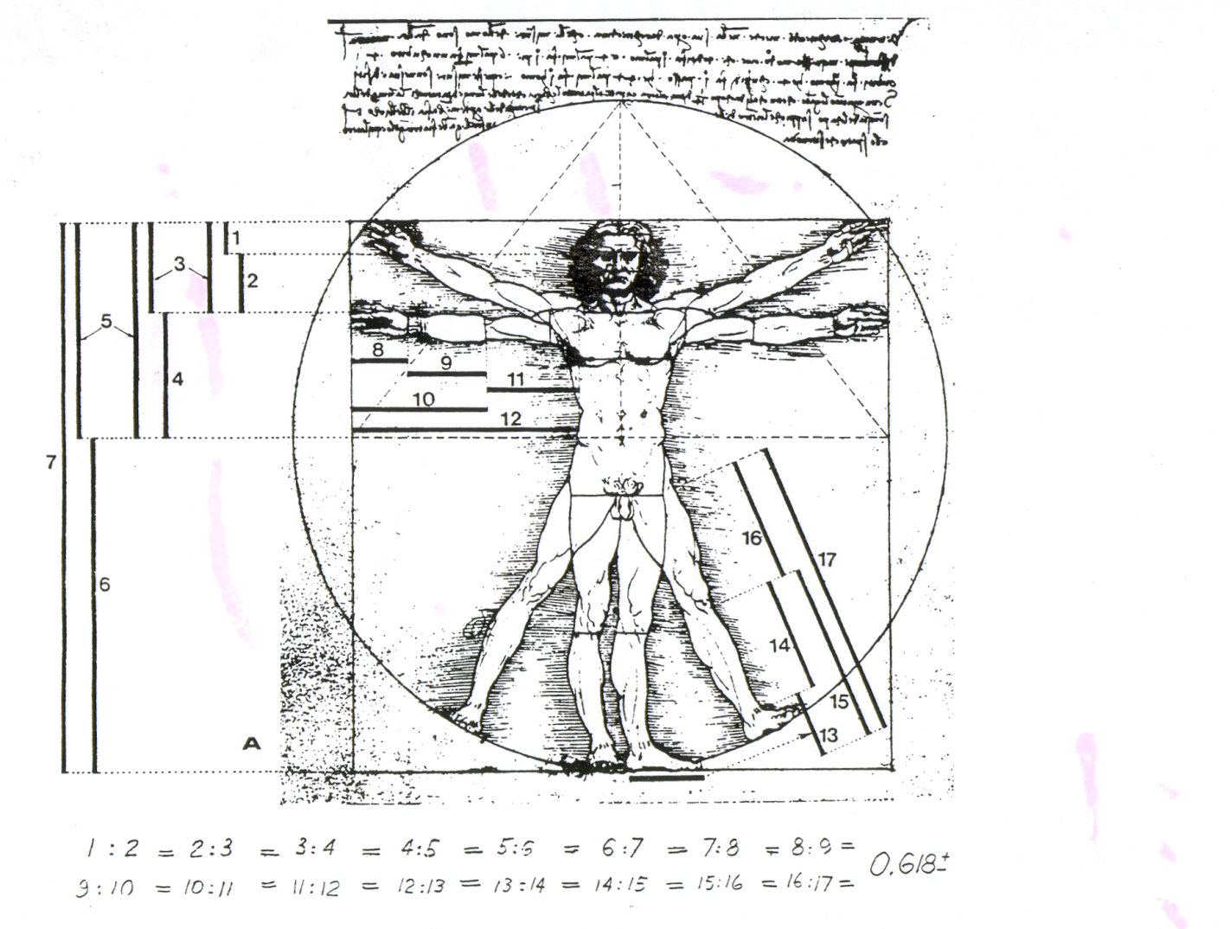

Slide 16
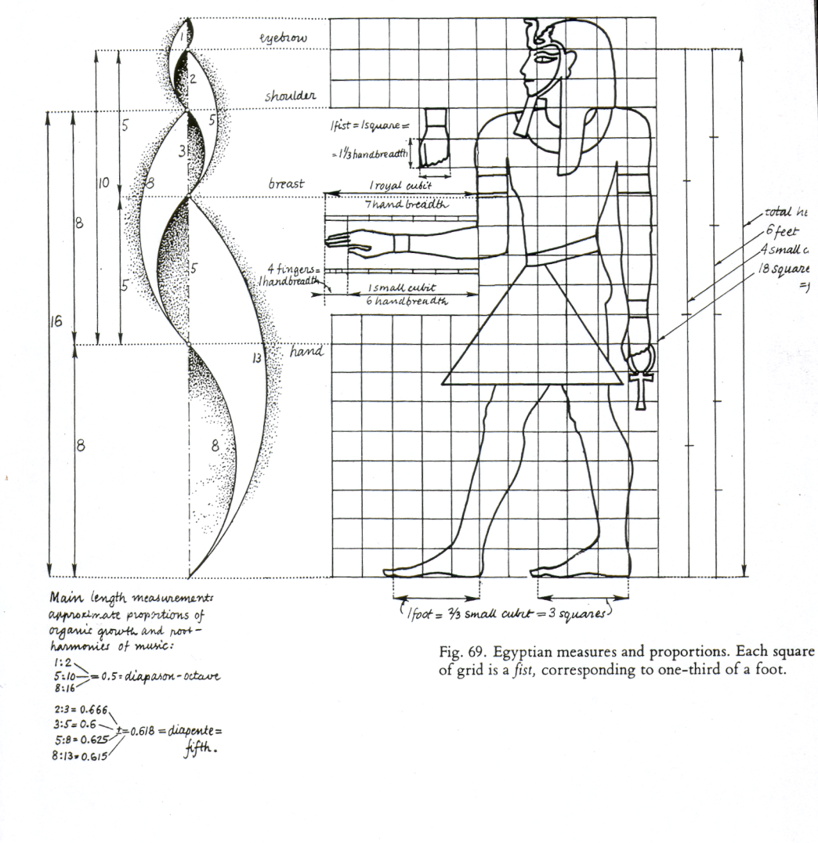

Slide 17
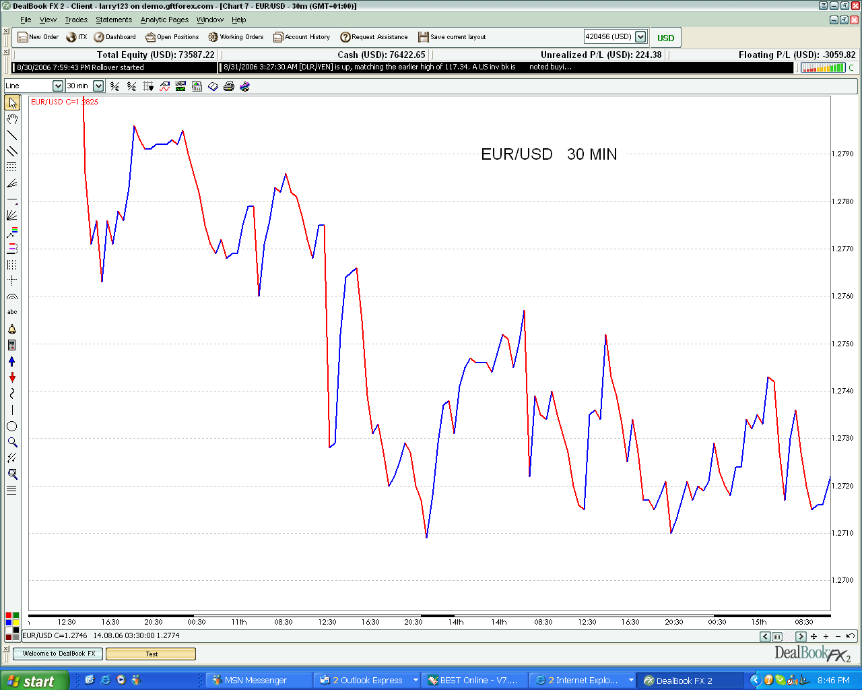

Slide 18
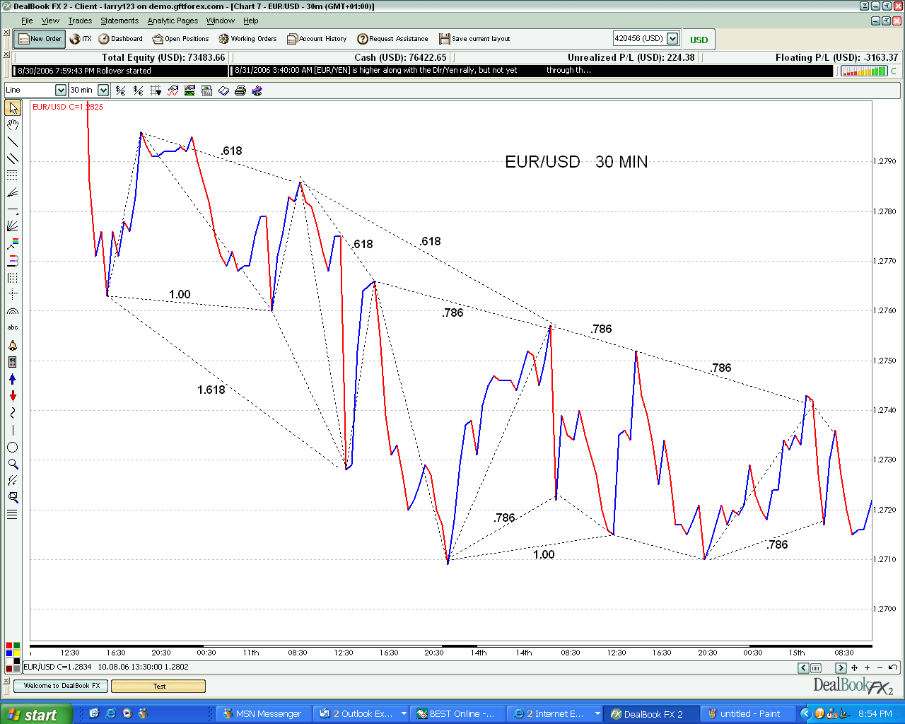

Slide 19
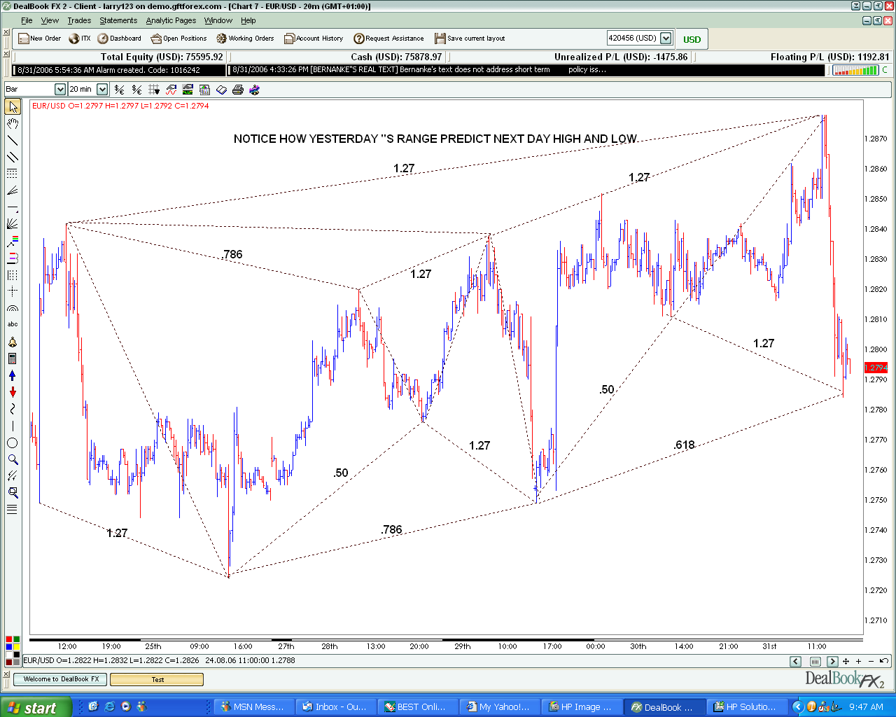

Slide 20
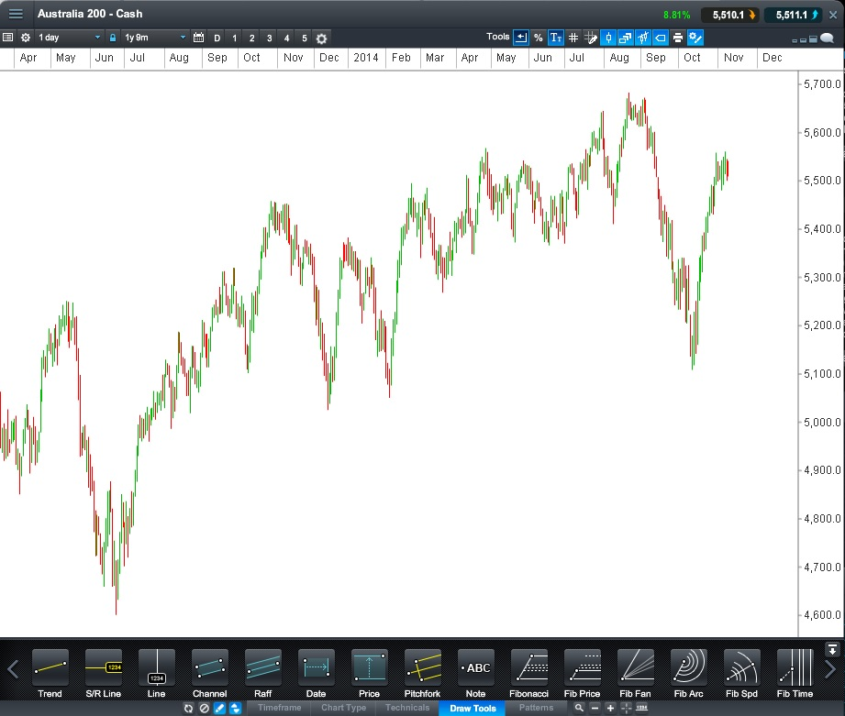

Slide 21
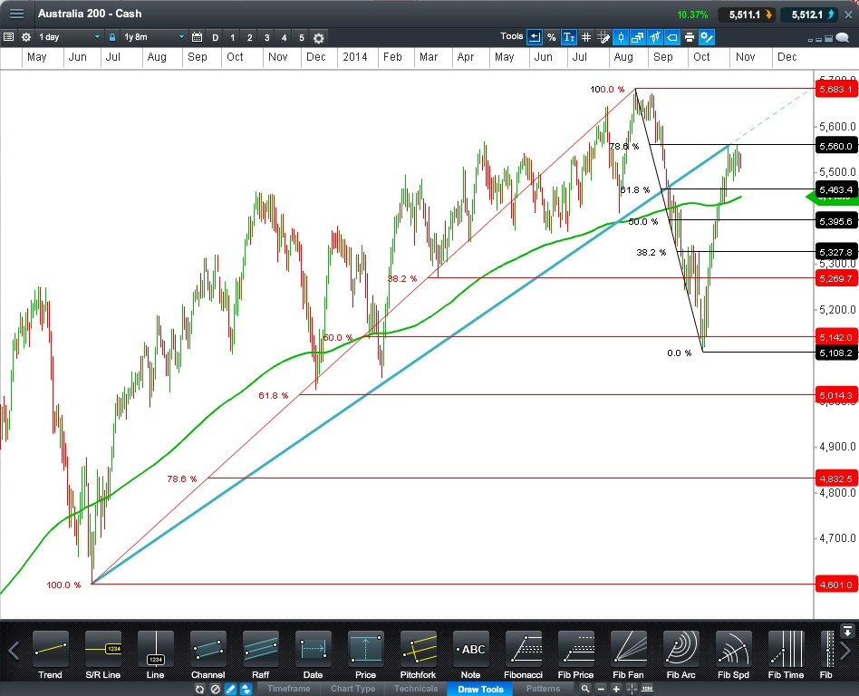

Slide 22


Slide 23
AB = CD Pattern
The AB=CD pattern is a simple but very powerful pattern. It is a measured move pattern where the first leg is equal to the second leg. It is the basic pattern in the theory of parallel channels. It can be described as a “lightning bolt” shape.
Markets move in waves and the AB=CD pattern can be used for entering trades and also for exiting trades. The risk can be determined by analyzing the failure point of the pattern.
The AB=CD is also the major component in the structure of the Gartley patterns.
As you study this pattern and become familiar with it you will no doubt discover its benefits as a trading pattern.
Look through many charts daily on all different time frames and you will find this pattern. As an exercise you can print out blank charts and identify and hand draw in the AB=CD. We encourage you to do as much hand drawing as possible of all of the patterns; it will most certainly help you to more quickly recognize the correct formation of these patterns.

Slide 24
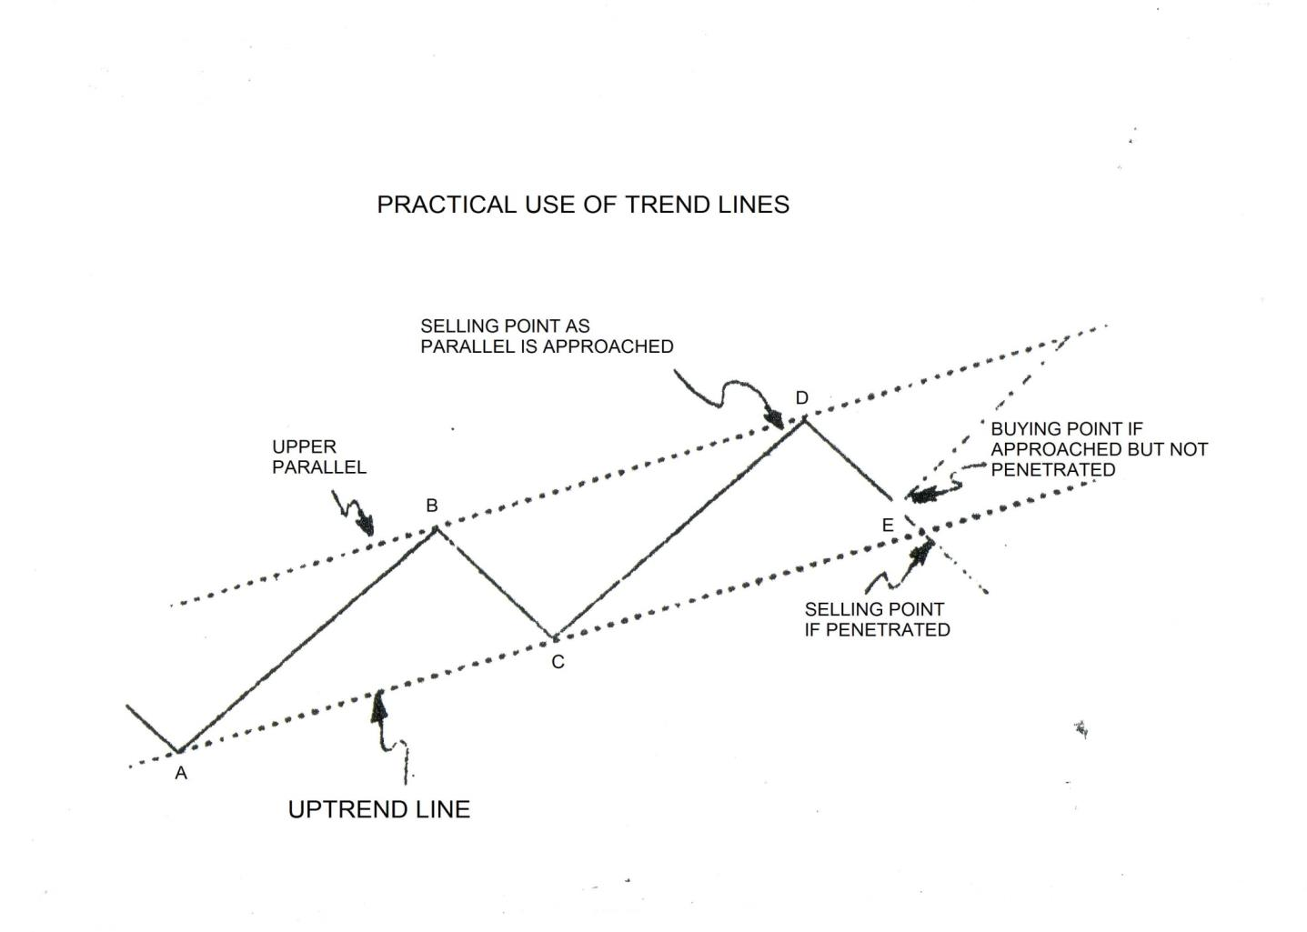

Slide 25
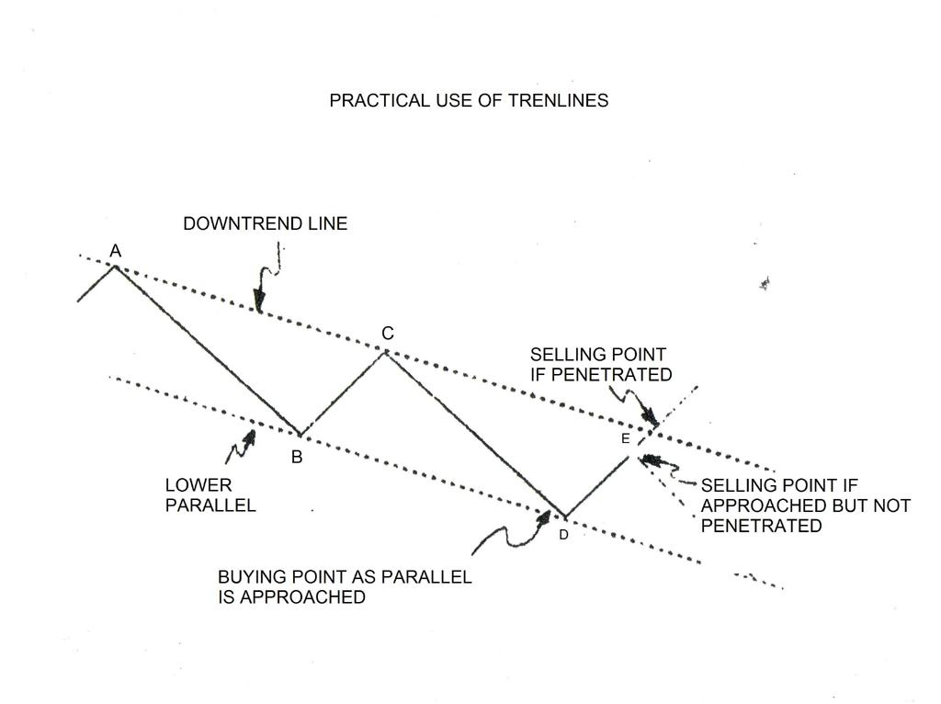

Slide 26
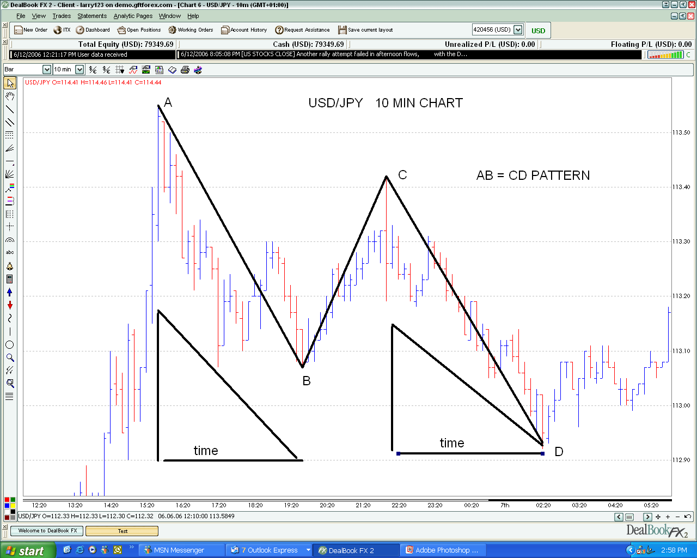

Slide 27
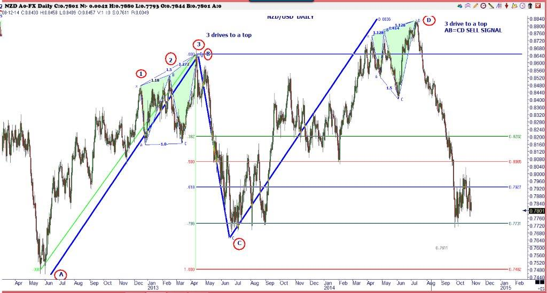

Slide 28
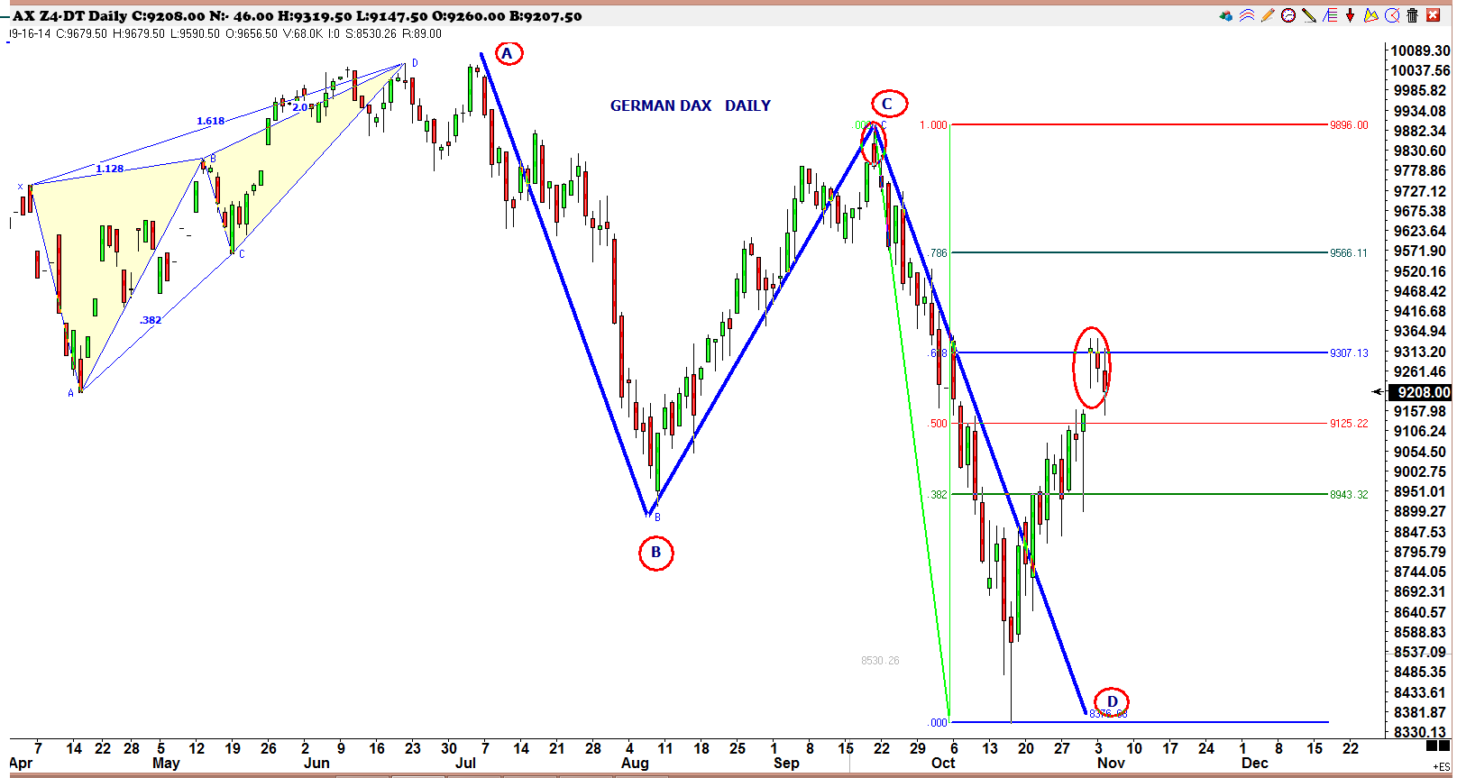

Slide 29
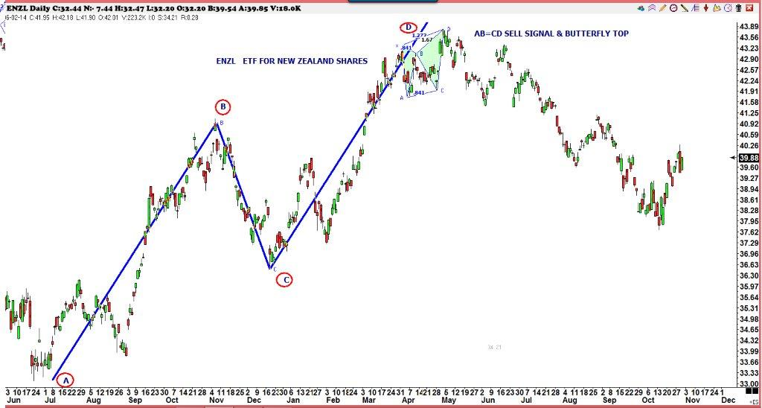

Slide 30
The Gartley “222” Pattern
The Gartley “222” pattern was named this because it is described on page 222 of H.M Gartley’s book, ‘Profits in the Stock Market’, first published in 1935.
The pattern contains the AB=CD pattern which allows the trader to calculate ratio and proportions of various price waves in order to determine the risk on the trade.
When the Gartley pattern fails (moves beyond “x”) it may turn into a butterfly pattern at the 1.27 or 1.618 extensions. Beyond these generally a trend move is in progress.
There are three ways a trader can be on alert for a failure of the Gartley pattern;
1/ A gap near the completion point.
2/ A wide range bar near the completion point.
3/ Tail closes near the completion point.
The completion of the “D” leg on a Gartley pattern may be beyond the .786 and close to the 1.00; as long as the 1.00 is not exceeded it is considered a Gartley pattern.
We would encourage you to print out blank price charts and hand draw as many patterns as you can while you are learning to recognize them.
More information on the Gartley Pattern can be found on page 45 in ‘Fibonacci Ratios with Pattern Recognition’ by Larry Pesavento.

Slide 31
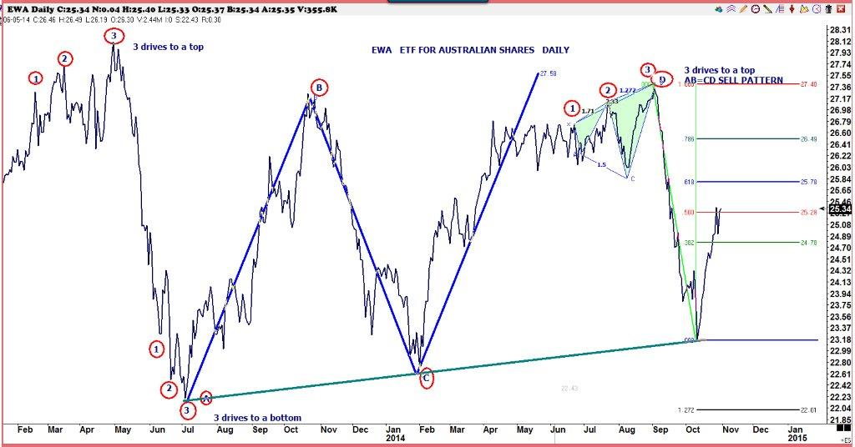

Slide 32
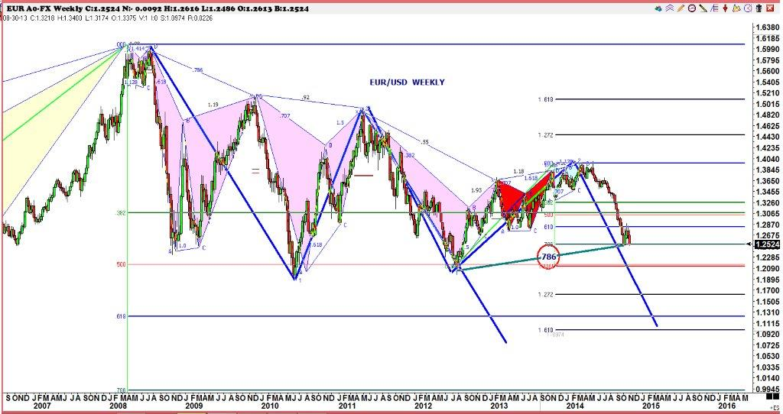

Slide 33
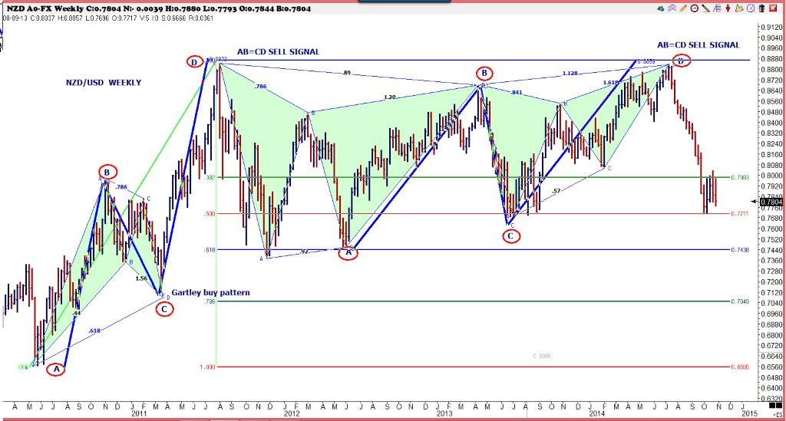

Slide 34
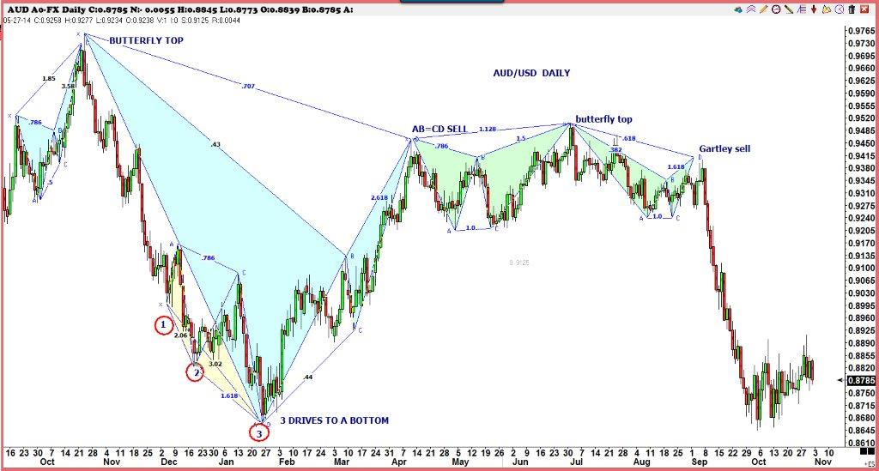

Slide 35
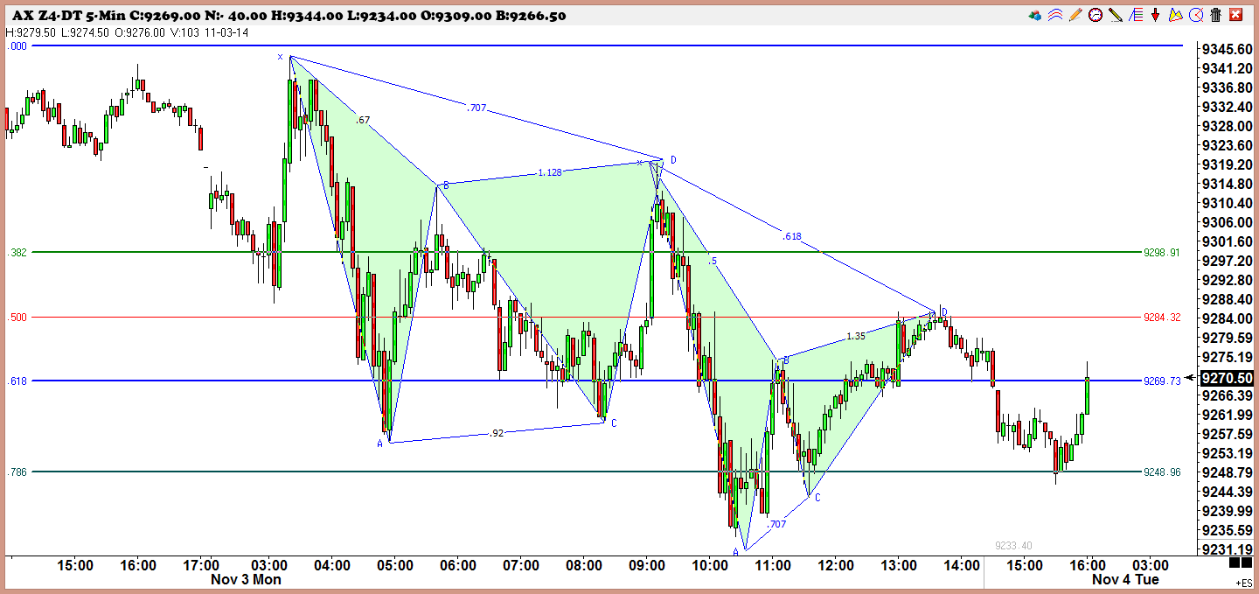

Slide 36
The Butterfly Pattern
The Butterfly pattern is an extension pattern and is found at significant tops and bottoms. It is formed by connecting two triangles and an AB=CD move is present in the pattern.
The extension move can be either 1.27 or 1.618. Any move beyond the 1.618 negates this pattern. If price moves beyond this level a strong continuation is in progress.
The retracement moves inside the pattern are generally .618 or .786. The risk in the trade can be determined by using the 1.27 or 1.618 levels.
Many times a failed Gartley pattern will turn into a butterfly pattern. The trader should watch for warning signs of wide range bars, gaps and tail closes towards the completion of the butterfly pattern.
The following pages have examples of Butterfly buy and sell patterns. We would encourage you to print out blank price charts and hand draw as many patterns as you can while you are learning to recognize them.
The Butterfly pattern is a powerful pattern and is one of our favorites. More information on this pattern can be found on page 104 of ‘Fibonacci Ratios with Pattern Recognition’ by Larry Pesavento.

Slide 37


Slide 38
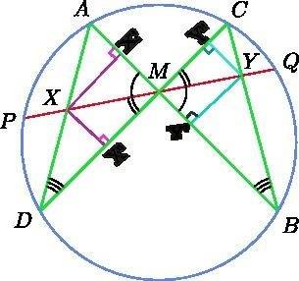

Slide 39
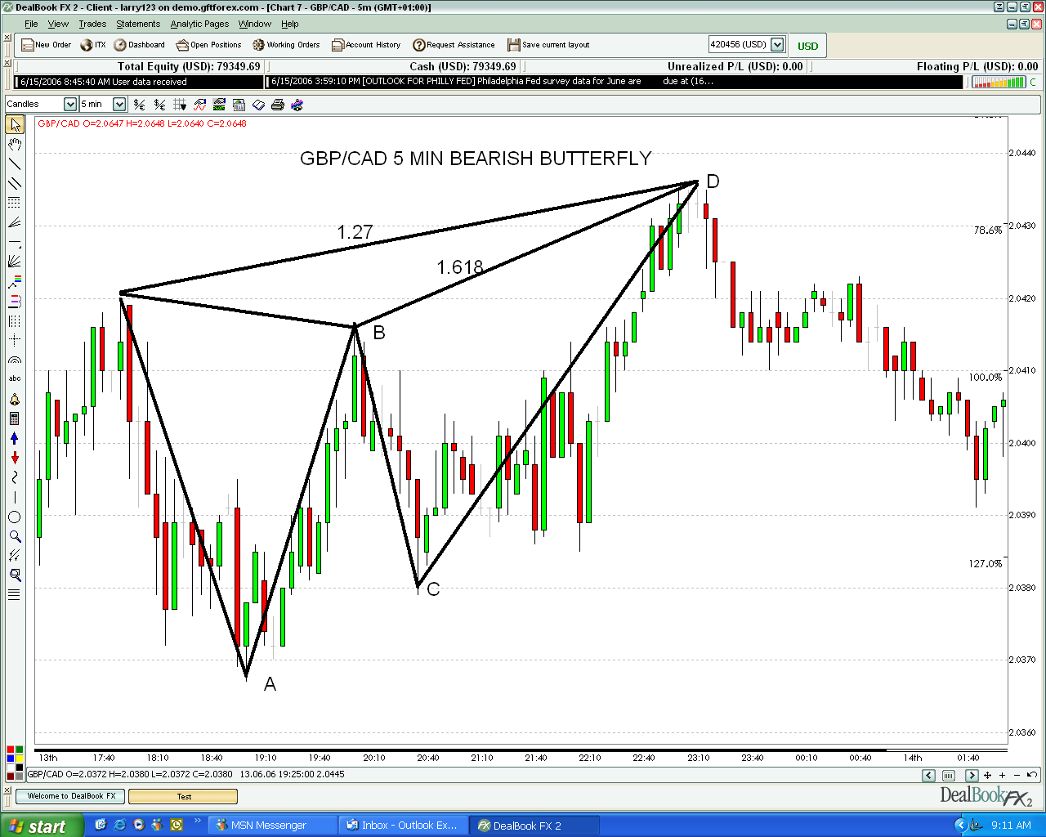

Slide 40
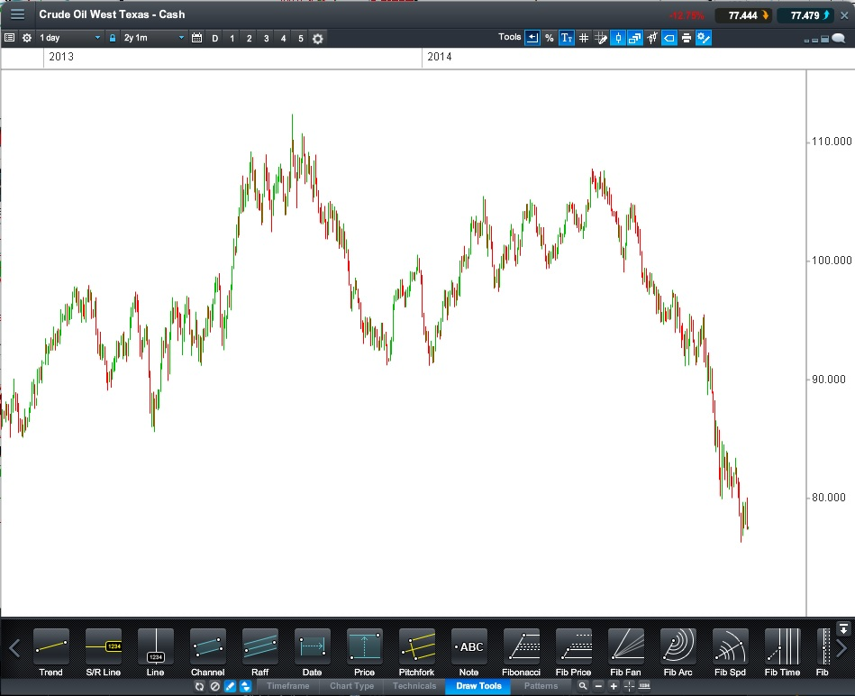

Slide 41
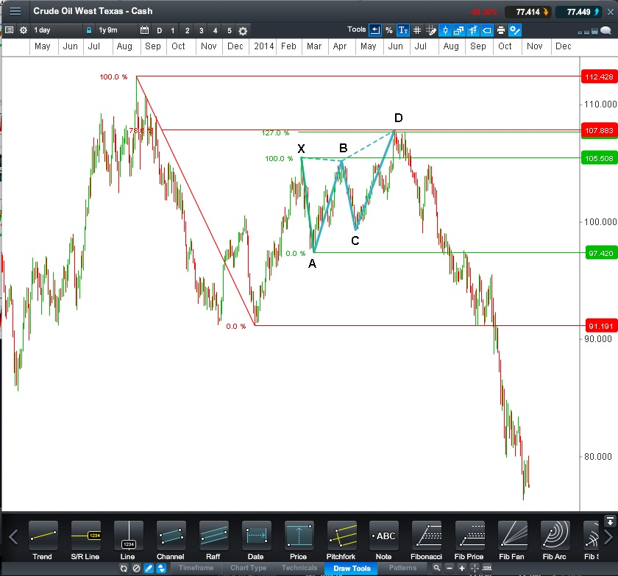

Slide 42
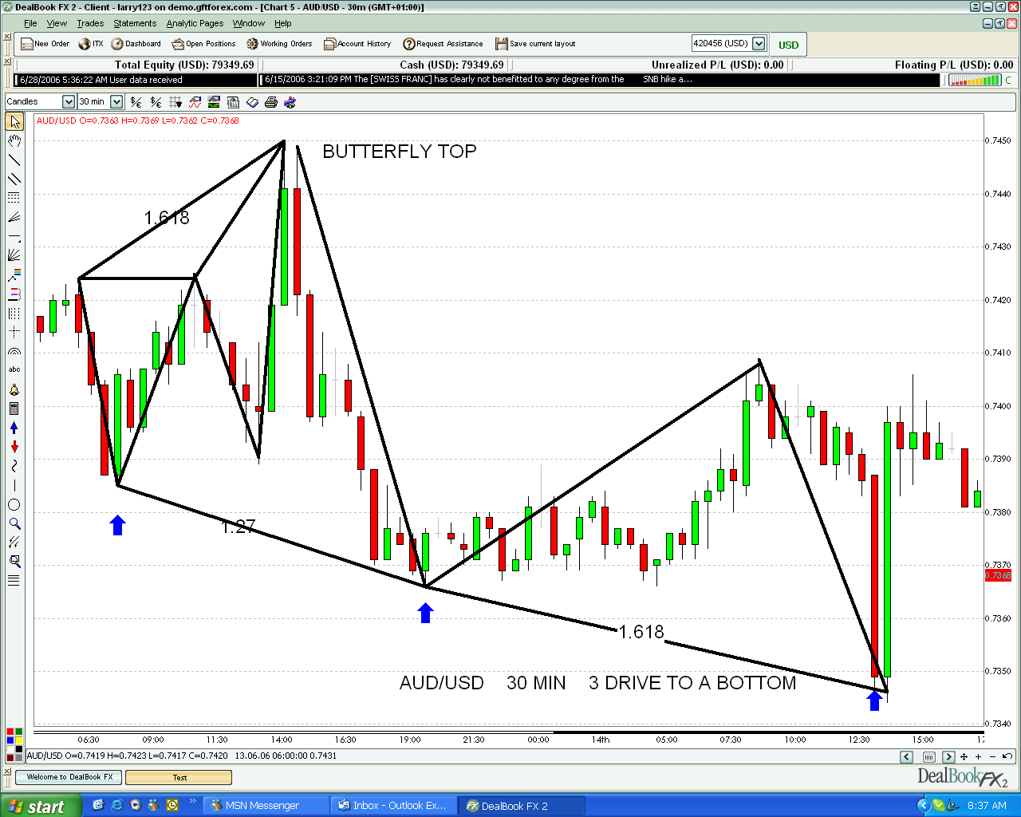

Slide 43
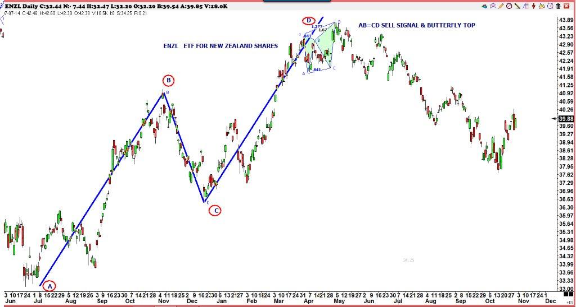

Slide 44
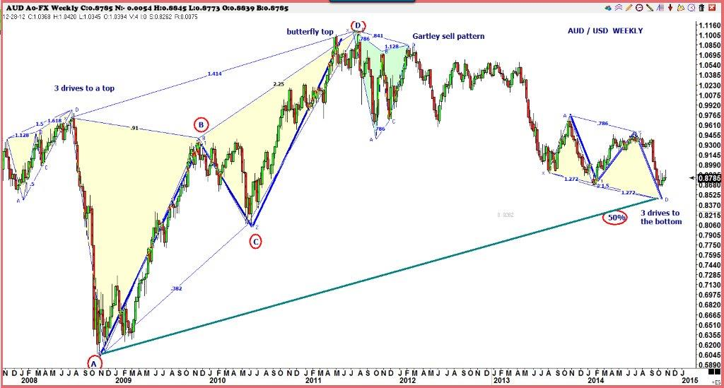

Slide 45
Three Drives Pattern
This is an extension pattern and is very symmetrical. This pattern should easily be recognized, if the trader has to force the pattern it probably is not a Three Drive pattern.
The Three Drive pattern is found at tops and bottoms of moves and can either be a sign of reversal of a trend or it can be a sign of a more complex correction in the trend, such as an AB=CD, before the trend continues. Since the trader never knows which it will be stops must always be used.
The second and third drive in this pattern should be 1.27 or 1.618 of the 1 to A and 2 to C swings. The retracement of the A and C will usually be .618 or .786, however in a strongly trending market they may be .382.
The trader should take warning if a large gap is present in this pattern and wait for further confirmation that a top or bottom is in place. When the Three Drives pattern fails it is will generally lead to a larger move in the direction of the trend.
The following pages have examples of both Three Drive buy and sell patterns. There is also exercise charts included for you to identify and hand draw in the pattern.
More information on the Three Drive pattern can be found on page 85 in ‘Fibonacci Ratios with Pattern Recognition’, by Larry Pesavento.

Slide 46
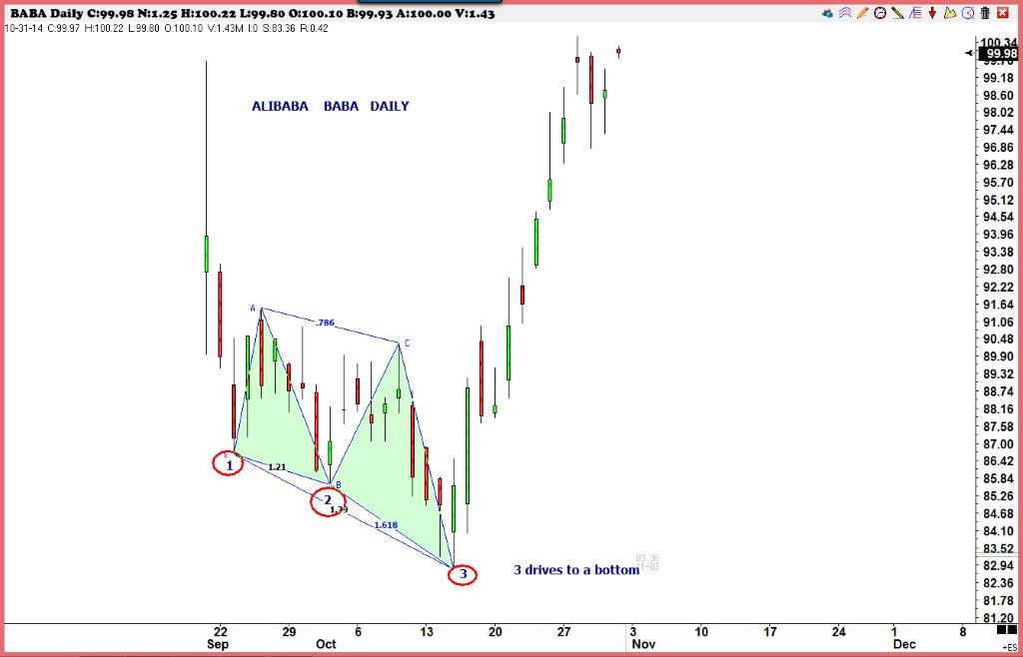

Slide 47
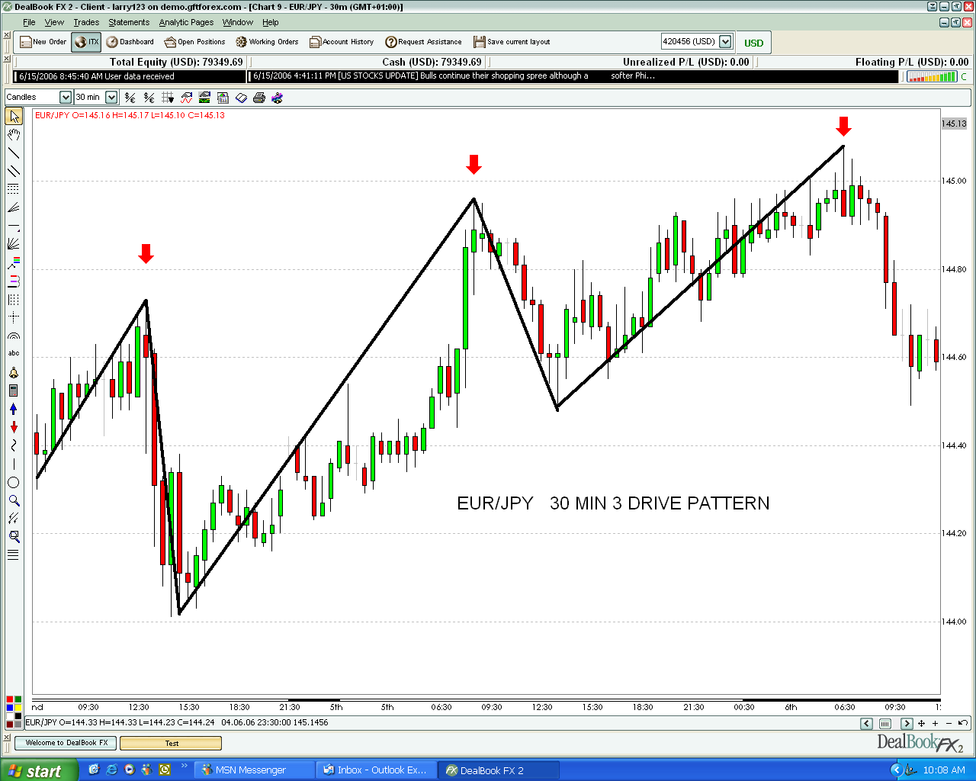

Slide 48
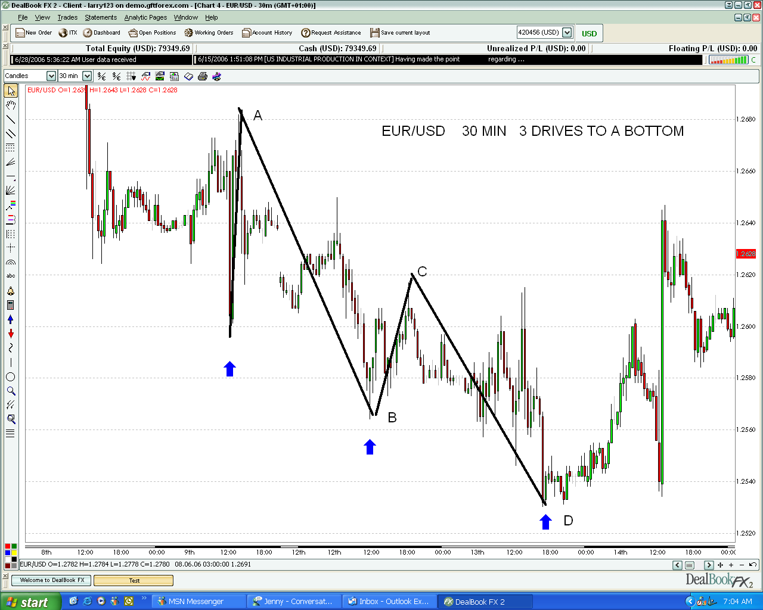

Slide 49
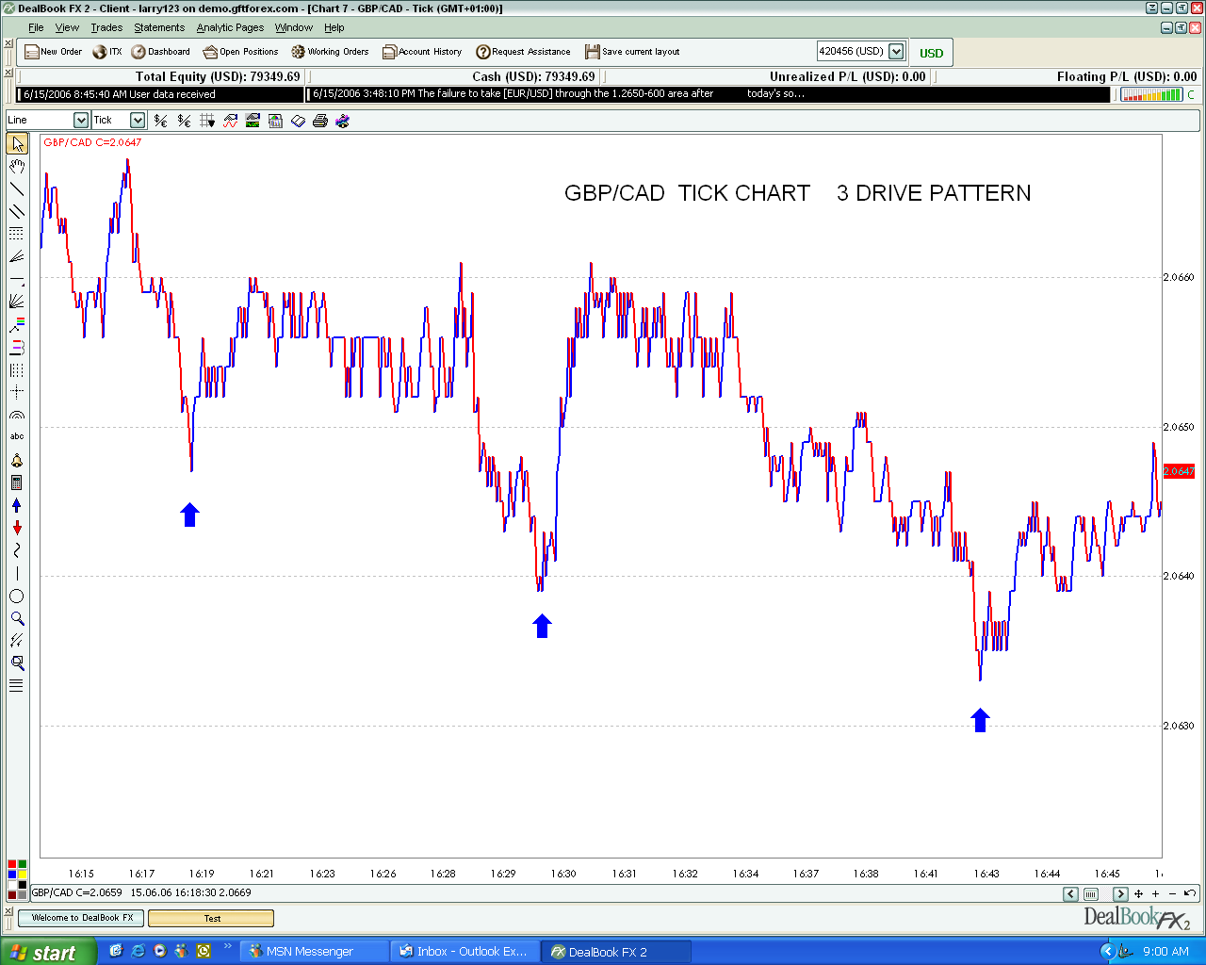

Slide 50
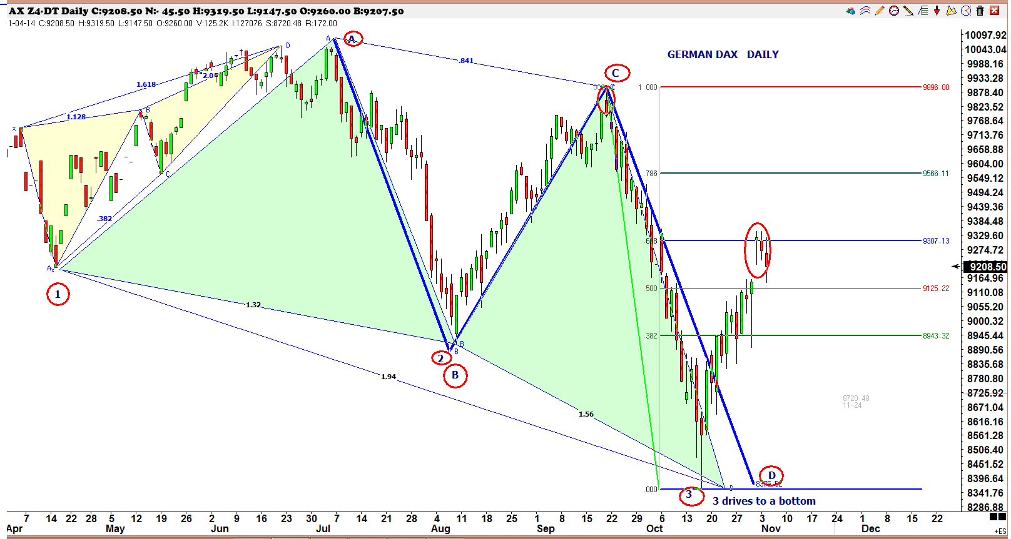

Slide 51
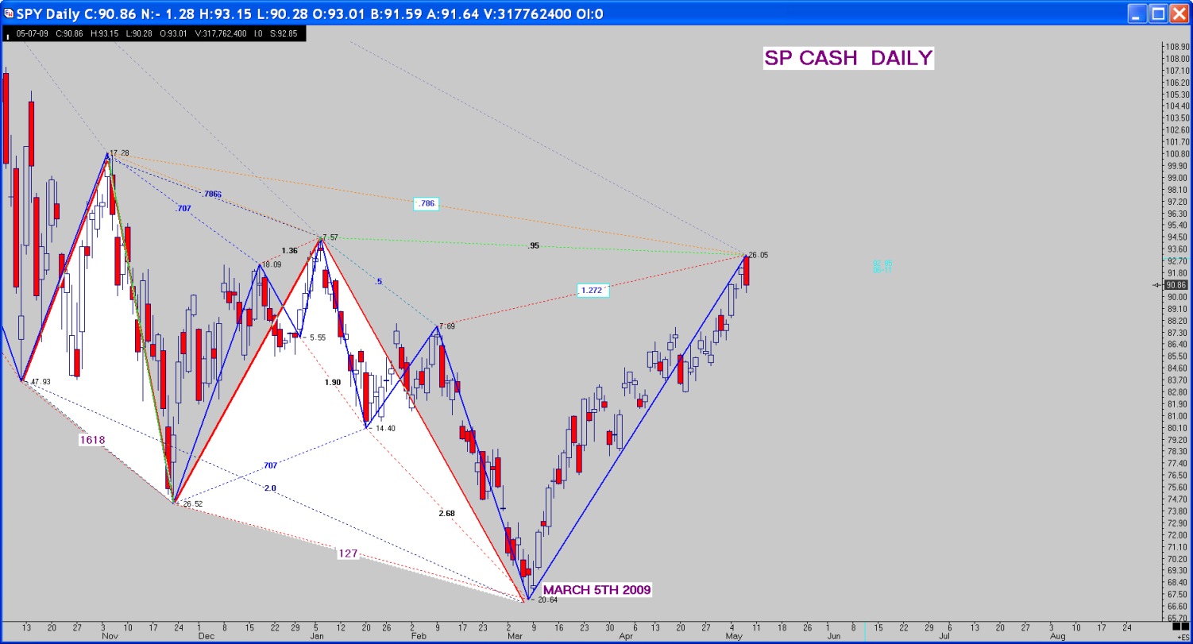

Slide 52
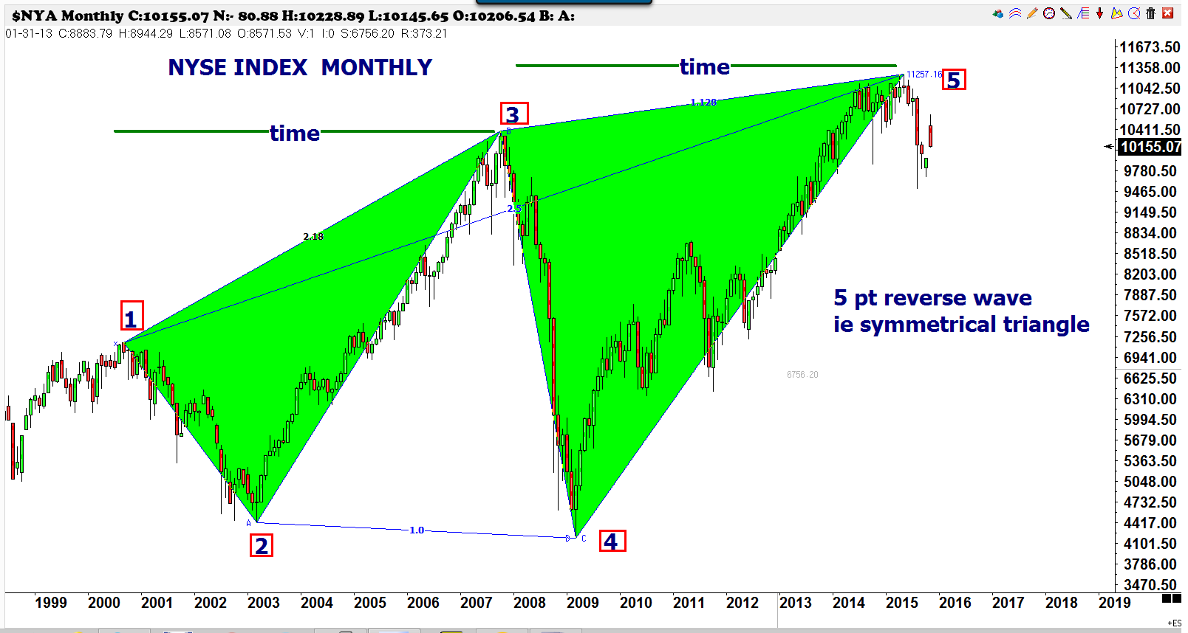

Slide 53
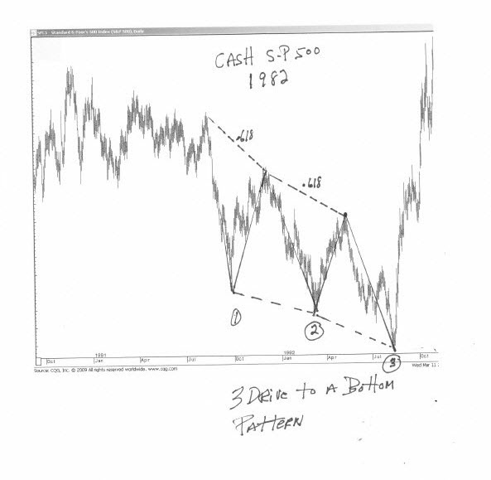
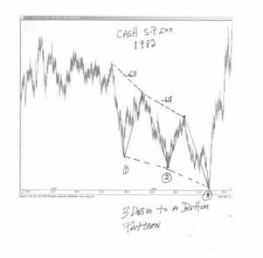

Slide 54
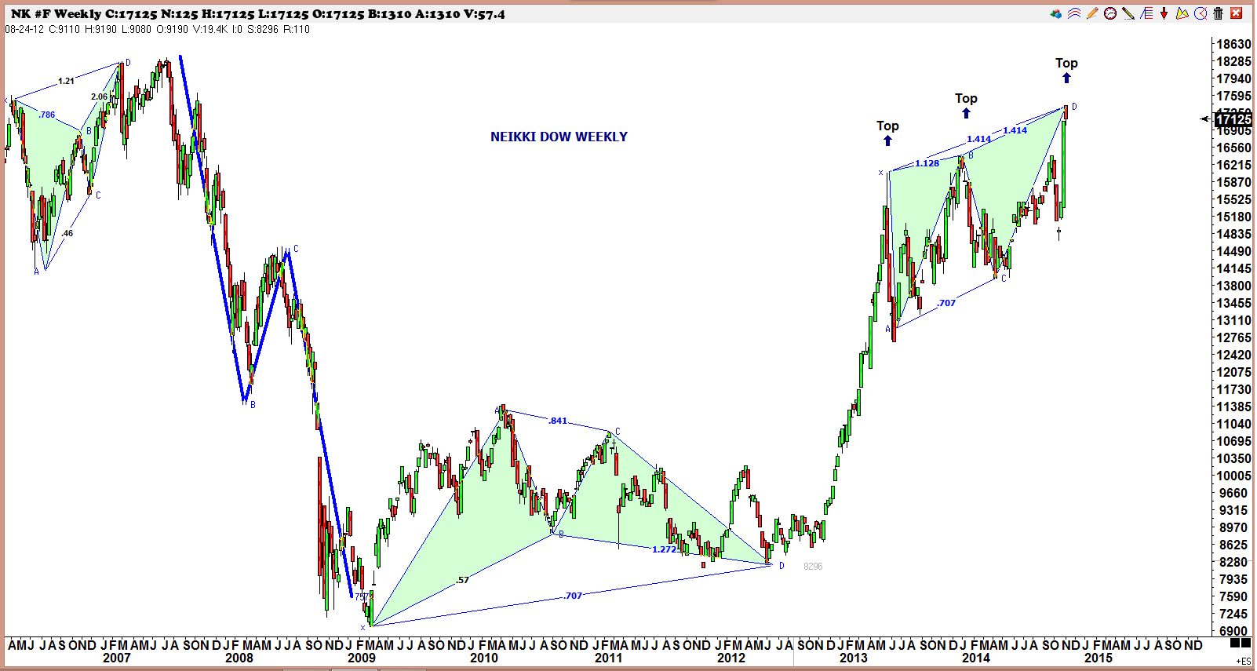

Slide 55
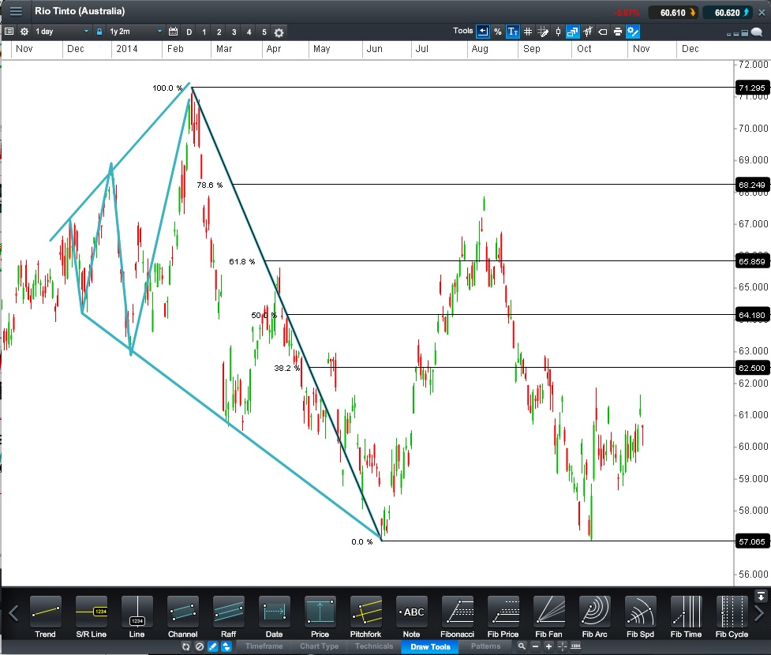

Slide 56


Slide 57


Slide 58


Slide 59


Slide 60


Slide 61


Slide 62
Harmonics
We want you to start thinking in terms of repetition and swings. Markets tend to repeat past measured moves and move in waves. You can find many examples for yourself by observing price charts in any time frame of this repetition. Every stock, commodity, etc. seems to have its own vibratory number.
The easiest way to describe why harmonic numbers work the way they do is to use an analogy. Suppose you drop a rock into a pool of water. Once the rock hits the water, waves will vibrate from the center of impact until the thrust of the rock hitting the water dissipates.
Markets can react to events in much the same way. You have probably observed many times the release of an economic number or news event and watched a price move or thrust on a reaction of the news. This would be equivalent to dropping a large rock from a good height into our pool of water.
You can find the most common harmonic swing in a market or stock by studying 30 minute charts over a 30 day period and observing the most common swings. After 100 samples one swing will appear prominent. For example some Forex primary harmonic numbers are;
EUR/USD = 60 pips
CHF/USD = 100 pips
GBP/USD = 90 pips
Harmonic numbers can be used in determining profit objectives and stop placement.
More harmonic number information can be found on page 17 of Fibonacci Ratios with Pattern Recognition.
Study the following chart examples of harmonic swings. Included are some blank charts for you to use as an exercise in finding and drawing in harmonic swings to help you begin recognizing these repetitive swings.

Slide 63

The Doppler Effect is a change in the observed frequency of sound or light resulting from the motion of a source or observer.
Successive wave crests emitted by a stationary source in all directions approach any stationary observer (A) at a constant distance, or wavelength, behind each other and at a constant frequency.
If the source moves away from an observer or the observer moves away from the source (B), the waves seem to be drawn out to longer wavelengths and are received at a lower frequency.
If the source approaches an observer or the observer moves toward the source, (C), the waves are crowded together; appearing shorter in wavelength and follow each other at a higher frequency.

Slide 64

To Contact Larry Pesavento:
Email: larry@tradingtutor.com
Phone: 1-520-529-0469

Slide 65


Slide 66


Slide 67
A Probabilistic Mindset From ‘Trading in the Zone’ By Mark Douglas
Learning to think of trading in terms of probabilities is one of the most important steps in becoming a successful and consistent trader.
Below is a list of 5 Fundamental Truths pertaining to a Probabilistic Mindset.
1/ Anything can happen.
2/ Every moment in the market is unique.
3/ An edge is nothing more than an indication of a higher probability of one thing happening over another.
4/ There is a random distribution between wins and losses on any given set of variables that define an edge.
5/ You don’t need to know what is going to happen next in order to make money.
The market is a constant and endless stream of opportunity. You must learn to identify and then act on those opportunities with an objective mind.
If you can begin to think in probabilities you will remove the stress and anxiety from your trading. You will no longer be attached to an idea of what you think a price “should” or “should not” do.
You can begin that process by studying the above Fundamental Truths and then applying them to your mindset and you’re trading.

Slide 68
7 Typical Trading Errors From ‘Trading in the Zone’ By Mark Douglas
Listed below are 7 typical trading errors made by traders before they have learned to think in probabilities.
Note the ones that pertain to your trading. Most traders have more than one error that they tend to repeat. These errors can be very costly and must be replaced with good trading habits.
1/ Hesitate, get in too late.
2/ Jump the gun, get in too soon.
3/ Define your risk, but don’t take your loss and it turns into a bigger loss.
4/ Don’t define your risk in advance of putting on a trade.
5/ Get out of a winning trade too soon, leave money on the table.
6/ Let a winning trade turn into a losing trade without having taken any profits.
7/ Move a stop closer to your entry point, get stopped out and then the market turns in your favor.
When you begin to develop and apply the correct trading principles to your trading you will notice “discipline” coming into your trading. This is a process that will take most traders patience and time.
If you make a mistake, correct it. Don’t beat yourself up. Focus on what you did correctly. On the next trade strive to execute the trade according to your trading plan.

Slide 69
Traders Creed From ‘Trading in the Zone’ By Mark Douglas
At some point in one’s trading some real soul searching must take place. The trader must eventually make a commitment to do whatever is necessary to trade successfully and consistently. These steps at first are not always the most comfortable and may feel very awkward.
But once the trader starts on this path and begins doing necessary steps they will discover that it is truly the path of least resistance. This is where the trader discovers that the ‘Holy Grail’ is within them.
I am a consistent winner because…
1/ I objectively identify my edges.
2/ I pre-define my risk of every trade.
3/ I completely accept the risk or I willingly let go of that edge.
4/ I act on my edge without hesitation.
5/ I continually monitor my susceptibility to market errors.
6/ I pay myself as the market makes money available to me.
7/ I am consistent because I never violate these principles of success.
As you are setting up and executing your trades use this list to determine if you are following ‘The Traders Creed’.

Slide 70
Trade Management
Once the trader has learned to recognize the patterns they must develop a trading plan for each pattern traded that will include entry, stop placement, money management and exit strategies. The trading plan should be as comprehensive as possible and should take into consideration unexpected events that occur from time to time in any market.
For each pattern you trade you should have at this point studied the pattern individually and know what the edge is in trading that pattern. We would encourage each trader to do simulated trading with each pattern they want to trade and continue that until they have at least 2 consecutive profitable months before moving on to trading real money.
There are many ways to manage trades and we will give you some guidelines and ideas here. But ultimately it is up to you to do your testing and research to develop your trading plan. The more experience, knowledge and skills you acquire the better your execution will become in trading. If you are new to trading, start small, you can always add contracts or shares as your account size and experience increase.
Set up a spreadsheet to track each pattern daily that you want to trade. For instance if you want to trade the Gartley pattern intraday on a 5 minute chart of the S&P then track the pattern and the trade management you want to apply to it for a minimum of 50 trades to see if you have an edge and can be profitable applying that particular trade management.
Once you have begun trading real money, Mark Douglas has an excellent exercise using 20 samples. There is a worksheet included in this workbook for you to use. You simply commit to trading 20 samples of your chosen methodology and track the outcome. If you have done your previous research of a minimum of 50 samples in a spreadsheet you should have a good idea if you are following your trade plan at the end of the 20 sample period. If you are also tracking how the pattern “should” have been traded and have a large difference in the outcome you can then spot the areas you need to work on in your execution skills.

Slide 71


Slide 72

To Contact Larry Pesavento:
Email: larry@tradingtutor.com
Phone: 1-520-529-0469

Slide 73


Slide 74


Slide 75


Slide 76
To Contact Larry Pesavento:
Email: larry@tradingtutor.com
Phone: 1-520-529-0469

